Slide 1
Software Engineering
Dr. Fatma ElSayed
Dr. Ahmed Yousry
Computer Science Department

Slide 2
Course Information
Contents
Introduction to Software Engineering
Software Processes
Requirements Engineering
System Modelling Part 1
System Modelling Part 2
System Modelling Part 3
Software Testing Part 1
Software Testing Part 2
System Architecture

Slide 3
Course Information
Contents
Introduction to Software Engineering
Software Processes
Requirements Engineering
System Modelling Part 1
System Modelling Part 2
System Modelling Part 3
Software Testing Part 1
Software Testing Part 2
System Architecture

Slide 4
Chapter 8: Software Testing

Slide 5
Software Testing
Software testing is the process of identifying the completeness, correctness, and quality of the developed software.
Testing is the process of executing program or application with the intent of finding errors.
To demonstrate to the developer and the customer that the software meets its requirements.
To discover situations in which the behavior of the software is incorrect, undesirable, or does not conform to its specification.
Notes:
undesirable system behavior such as system crashes, unwanted interactions with other systems, incorrect computations, and data corruption.

Slide 6
Who Should Test?
To be most effective, testing should be conducted by an independent third party.
Verification
Validation
"Are we building the product right”
During development
Involves checking documents provided by humans.
Process-oriented
Does not require code execution, so it is considered static testing
"Are we building the right product”
After development, pre-release
Involves the execution of a program by a computer
Product-oriented
Requires code execution, so it is considered dynamic testing
Notes:
Developers and in-house teams might have a psychological bias toward the software they have built, potentially overlooking issues or downplaying certain defects.

Slide 7
Testing Stages
A commercial software system has to go through three stages of testing:
Development testing
Where the system is tested during development to discover bugs and defects. System designers and programmers are likely to be involved in the testing process.
Release testing
Where a separate testing team tests a complete version of the system before it is released to users. The aim of release testing is to check that the system meets the requirements of system stakeholders.
User testing
Where users or potential users of a system test the system in their own environment. For software products, the ‘user’ may be an internal marketing group who decide if the software can be marketed, released, and sold.

Slide 8
Testing Stages
Development testing
Release testing
User testing
Levels
Unit testing
Integration testing
System testing

Slide 9
Testing Stages
Development testing
Release testing
User testing
Levels
Unit testing
Integration testing
System testing

Slide 10
Unit Testing Considerations
Where individual program units or object classes are tested. Unit testing should focus on testing the functionality of objects or methods.
The module interface is tested to ensure that information properly flows into and out of the program unit under test. Tests of data flow across a module interface are required before any other test is initiated.
Interface Testing Involve:
Input Validation
Output Validation
Error Handling
Ex: Suppose you're testing a login module:
Input: Username and password.
Output: A success message or error.
Interface testing would ensure:
Username and password are received correctly.
Errors are properly returned for invalid inputs.
The output format matches expectations.

Slide 11
Unit Testing Considerations
Among the more common errors in computation are:
Misunderstood or incorrect arithmetic precedence
Incorrect initialization
Incorrect symbolic representation of an expression.
Boundary conditions
Comparison (change of flow frequently occurs after a comparison), test cases should uncover errors such as:
Comparison of different data types
Incorrect logical operators or precedence
Improper loop termination or modified loop variables
Notes:
Software often fails at its boundaries. (That is, errors often occur when the nth element of an n-dimensional array is processed, when the ith repetition of a loop with i passes is invoked, when the maximum or minimum allowable value is encountered.)

Slide 12


Testing Methodology
Full Knowledge
Testing as a Developer
Used to check that the details of an implementation are correct.
Zero Knowledge
Testing as a User
Used to test that each of the customer's requirements is handled correctly

Slide 13
White Box Testing Techniques
Basis Path Testing
It is a white-box testing technique based on the control structure of a program or a module.
All independent paths (basis paths) through the control structure are exercised to ensure that all statements in a module have been executed at least once.
To design test cases using this technique, four steps are followed:
Construct the Control Flow Graph(CFG)
Compute the Cyclomatic Complexity Metric(CCM) of the Graph
Identify the Independent Paths
Design Test cases from Independent Paths

Slide 14
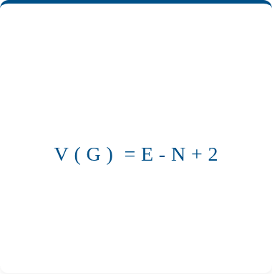

White Box Testing Techniques
Basis Path Testing
(1)
(2)
(3)
(4)
Construct the Control Flow Graph(CFG)
Compute the Cyclomatic Complexity Metric(CCM) of the Graph
Identify the Independent Paths
Design Test cases from Independent Paths
14

Slide 15
White Box Testing Techniques
Basis Path Testing
(1)
Construct the Control Flow Graph(CFG)
15

Slide 16
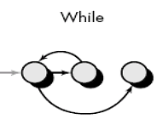
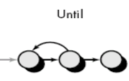

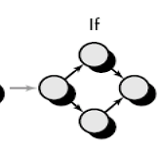
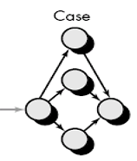
Flow Graph Notation
Control Flow Graph is represented differently for all statements and loops.
Sequence
While
Do-while
if
Case

Slide 17
Flow Graph
Each circle, called a flow graph node, represents one or more procedural statements.
A sequence of process boxes and a decision diamond can map into a single node.
The arrows on the flow graph, called edges or links, represent a flow of control.
Areas bounded by edges and nodes are called regions. When counting regions, we include the area outside the graph as a Region.
Each node that contains a condition is called a predicate node and is characterized by two or more edges come out from it.
Notes:
There can be more than one terminal node in a program.

Slide 18
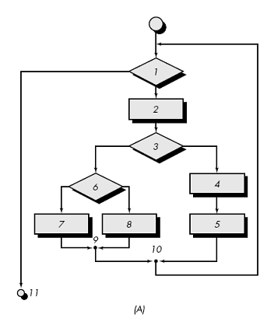
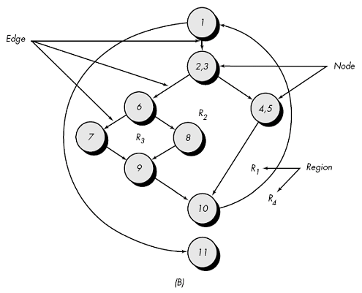
Flow Chart vs Flow Graph

Slide 19
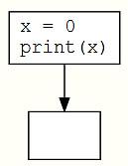
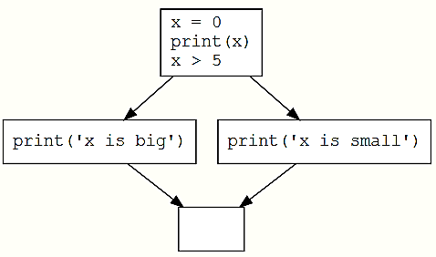
Flow Graph
1
x = 0
print(x)
Predicate node
2
Region
1
x = 0
print(x)
if (x > 5)
print('x is big')
else:
print('x is small')
2
3
4

Slide 20
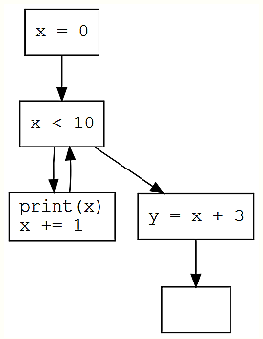
Flow Graph
void fun(){
x = 0
while (x < 10){
print(x)
x += 1
}
y = x + 3
}
1
2
4
3
5

Slide 21
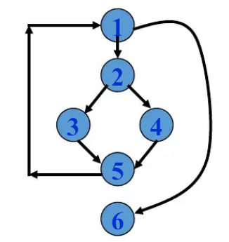
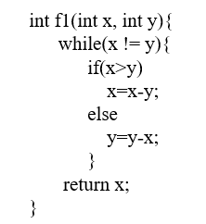
Flow Graph

Slide 22
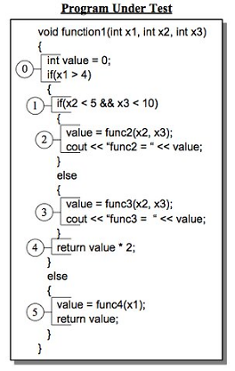
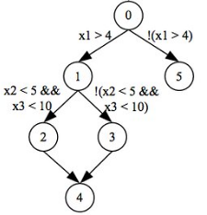
Flow Graph Notation
Notes:
There can be more than one terminal node in a program.

Slide 23
White Box Testing Techniques
Basis Path Testing
(1)
(2)
Construct the Control Flow Graph(CFG)
Compute the Cyclomatic Complexity Metric(CCM) of the Graph
23

Slide 24
Cyclomatic Complexity
It is a software metrics that provides a quantitative measure of the logical complexity of a program.
It defines no. of independent paths in the basis set, and
Provides an upper bound for the no. of tests that must be conducted.

Slide 25
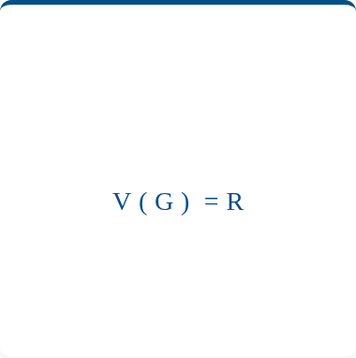
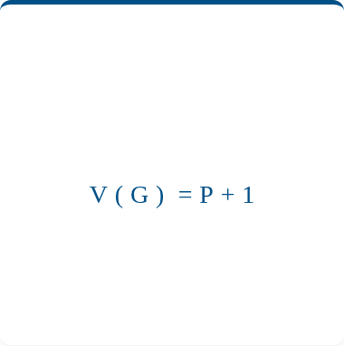



Cyclomatic Complexity
Three Ways to Measure
Graph Theory
Regions
Predicates
Calculates based on structural elements (Edges and Nodes).
Calculates based on enclosed areas plus the exterior.
Calculates based on decision points (If, While, Case).

Slide 26
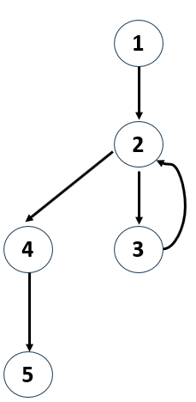
Cyclomatic Complexity
Cyclomatic Complexity
V(G) = R, the flow graph has 2 regions.
V(G) = E-N+2 = 5 edges – 5 nodes +2 = 2.
V(G) = P+1 = 1 predicate nodes + 1 = 2
*
R
*

Slide 27
Cyclomatic Complexity
Cyclomatic Complexity
V(G) = R, the flow graph has 3 regions.
V(G) = E-N+2 = 7 edges – 6 nodes +2 = 3.
V(G) = P+1 = 2 predicate nodes + 1 = 3

Slide 28
Cyclomatic Complexity
Cyclomatic Complexity
V(G) = R, the flow graph has 2 regions.
V(G) = E-N+2 = 6 edges – 6 nodes +2 = 2.
V(G) = P+1 = 2 predicate nodes + 1 = 3

Slide 29
Cyclomatic Complexity: Notations
When to Calculate (The Two Scenarios)
Ideal Code (Planar Graph / One Exit Node)
The Control Flow Graph (CFG) is Planar and has a single, clear exit point (only one return or end point). This represents well-structured code .
The Rule: All three formulas agree.
Complex Code (Multiple Exit Nodes)
The CFG has Multiple Exit Nodes (e.g., multiple return, break, or exit() calls).This represents less-structured or complex code.
The Rule: Depend only on the predicate formula.

Slide 30
Cyclomatic Complexity
Cyclomatic Complexity
The flow graph has 4 regions.
V(G) = 11 edges – 9 nodes +2 = 4.
V(G) = 3 predicate nodes + 1 = 4
Often components with a high V(G) are a high risk for error and should be tested more completely.

Slide 31
White Box Testing Techniques
Basis Path Testing
(1)
(2)
(3)
(4)
Construct the Control Flow Graph(CFG)
Compute the Cyclomatic Complexity Metric(CCM) of the Graph
Identify the Independent Paths
Design Test cases from Independent Paths
31

Slide 32
Thank You

